Slide 1

Community meeting
21st of November 2024
This meeting will
be recorded

Slide 2
The community
Infrastructure Developers
Committers & contributors
Algorithm Developers
Creating federated analysis algorithms
Users
Use vantage6 for privacy preserving analysis

Slide 3


Aim
Collaboration opportunities
Finding common interests by sharing what you are working on
Share what you are working on, Pitch a feature, … (Suggestions?)
Align development efforts
Avoid doing things twice
Bug reports
Please submit these in our issue tracker:
https://github.com/vantage6/vantage6/issues

Slide 4
Agenda
11:00 Short introduction
11:05 Announcements and upcoming events
11:10 Recently released
11:20 Infrastructure development
11:35 Algorithm development
11:45 Proposed features
11:55 Miscellaneous

Slide 5
Announcements and upcoming events

Slide 6
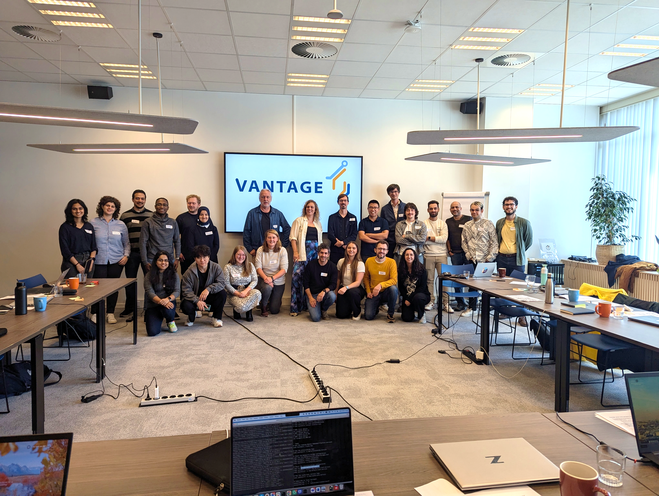
Past Event : vantage6 workshop
On the 16th and 17th of October we organized our very first vantage6 workshop.
The participants were very engaged and it was overall a great experience!
Contributors:
IKNL: Frank Martin, Bart van Beusekom
eScience center: Walter Baccinelli, Hector Cadavid, Cunliang Geng, Djura Smits
Many thanks to Kimberly Zwiers from the TDCC Life Sciences and Health for providing the venue!
Date: 17-18 October 2024

Slide 7

Upcoming event: SURF research bootcamp
SURF is organizing a research bootcamp on December 3rd. One of the sessions will be a quick 2-hour taster class on vantage6. There are still places available!
Register at:
https://www.surf.nl/en/agenda/surf-research-bootcamp-0
Contributors:
Djura Smits, Walter Baccinelli (eScience)
Date: 3 December 2024

Slide 8
Recently released
4.7.1-4.8.0 (2 releases)

Slide 9
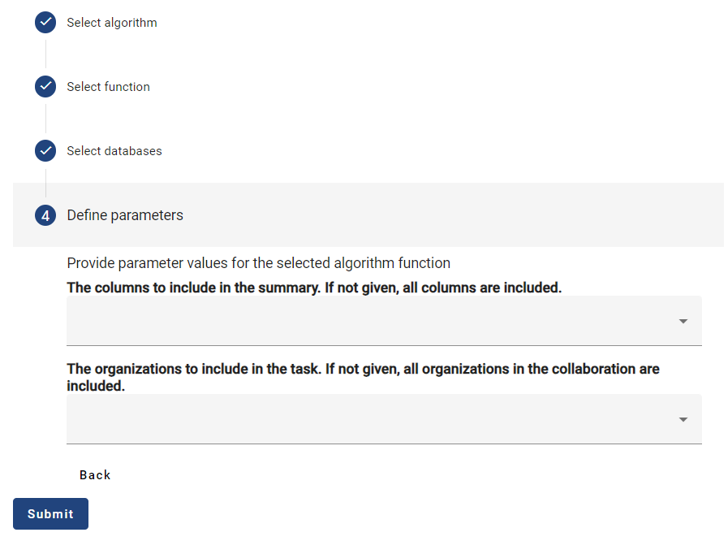
Default values for function parameters in algorithm store
When running algorithms via the Python client, we often don’t provide algorithm arguments because they have default values.
Now, the same can be done in the UI because the algorithm store saves default values
Contributors: Bart van Beusekom (IKNL)
[Feature Request] Indicate whether arguments are optional and have default values

Slide 10
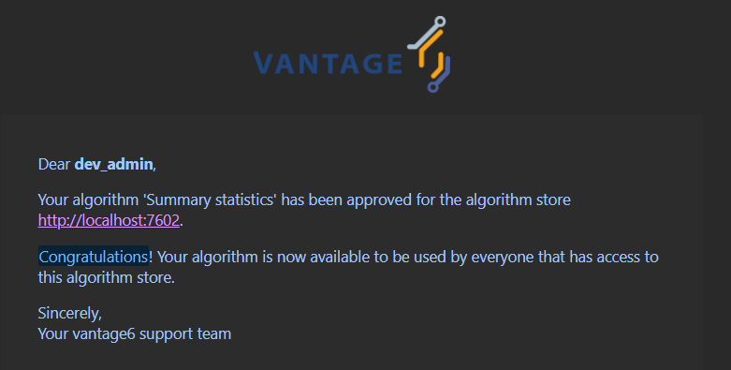
Emails to accompany algorithm review process
Upon submission of a new algorithm into an algorithm store, there is a review process to go through. We have now implemented email notifications to notify you when 1) you have to assign reviewers, 2) you are asked to review, 3) your review is no longer required, or 4) your algorithm is approved/rejected
Contributors: Bart van Beusekom (IKNL)
[Feature Request] Emails for algorithm reviews

Slide 11

Mount directories as databases on node
Up to now, you could mount files into the node as file-based databases. Now, you can also mount a full directory as node database.
When using this, the algorithm is responsible for reading data from files in that directory.
Contributors: Melle Sieswerda (IKNL)
[Feature Request] Enable directory mounts for local read/write

Slide 12

Flexible API path for algorithm store
API path for algorithm store was fixed at `/api` (same default as vantage6 server). This was inconvenient for people using custom paths with e.g. nginx as some features would not work properly. Now, the API path is settable same as for the server.
Contributors: Bart van Beusekom (IKNL)
[Change Request] Make api path settable in the algorithm store

Slide 13
Other changes
18
bugfixes
5
changes
7
features
0
security
patch
For full log of changes, see https://docs.vantage6.ai/en/main/release_notes.html
Notes:
Dit is een voorbeeld

Slide 14
Infrastructure development
Upcoming features and changes

Slide 15
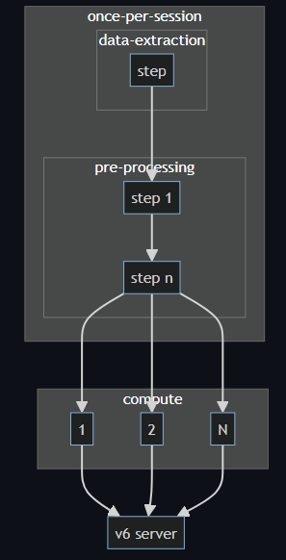
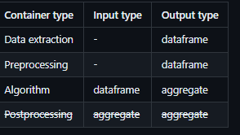
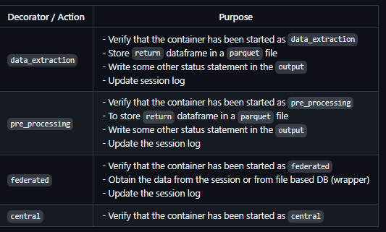
Feature: Algorithm container chaining
Split responsibilities of the algorithm containers:
Data extraction
Preprocessing
Algorithm (federated / central)
It has the following advantages:
The different components can be used modular.
The UI/UX task flow more consistent for different data source types.
Reuse the data-extraction / pre-processing step for multiple analysis making it quicker and less error prone
Contributors: Frank Martin (IKNL), Bart van Beusekom (IKNL), …
Estimate: Q1 2025
[Feature Request] Chaining of algorithm containers · Issue #943 · vantage6/vantage6 · GitHub

Slide 16
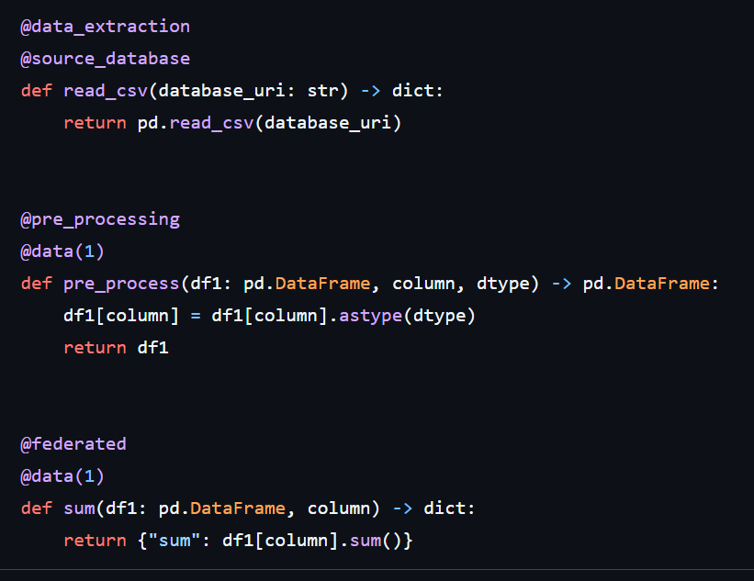
Feature: Algorithm container chaining
Different actions can still be stored in a single file and in a single image.
Migrating old algorithms should be a matter of splitting bigger functions into smaller ones.

Slide 17
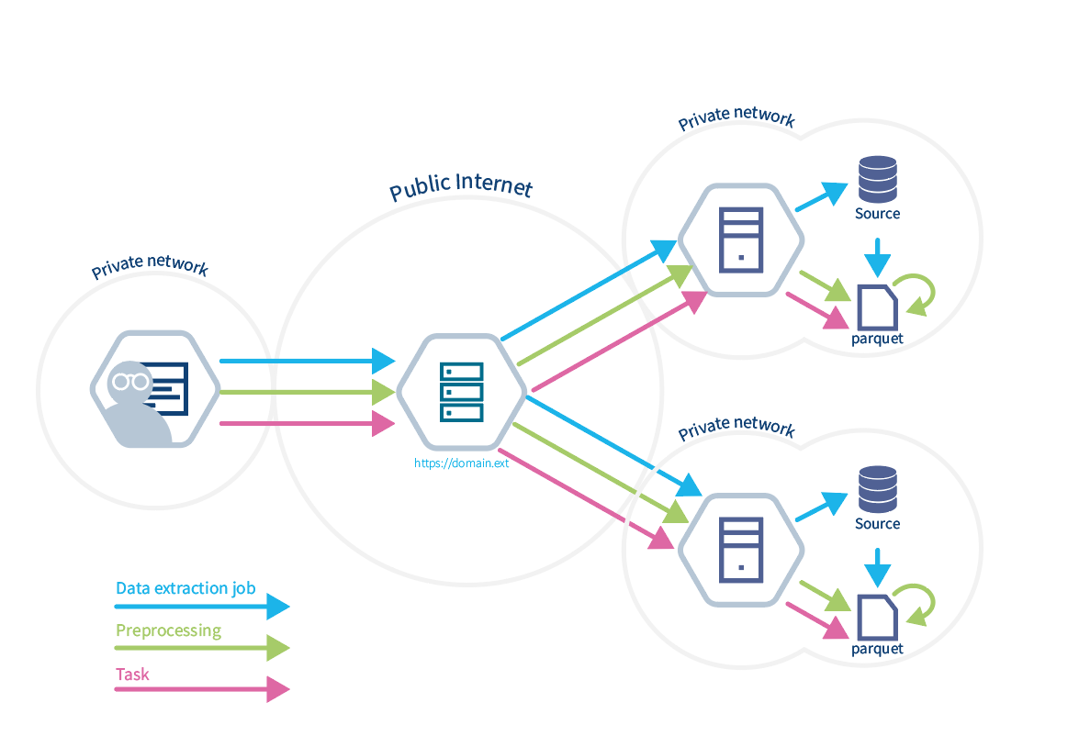
Feature: Algorithm container chaining
Three different requests (researchers can just use one if someone else prepared the dataset).
You can run many tasks on the session data frame
There is a locking mechanism that prevents you from updating data frames that are currently in use by computations
You can add preprocessing steps at a later stage
Use has instant access to column names and types after session initialization

Slide 18
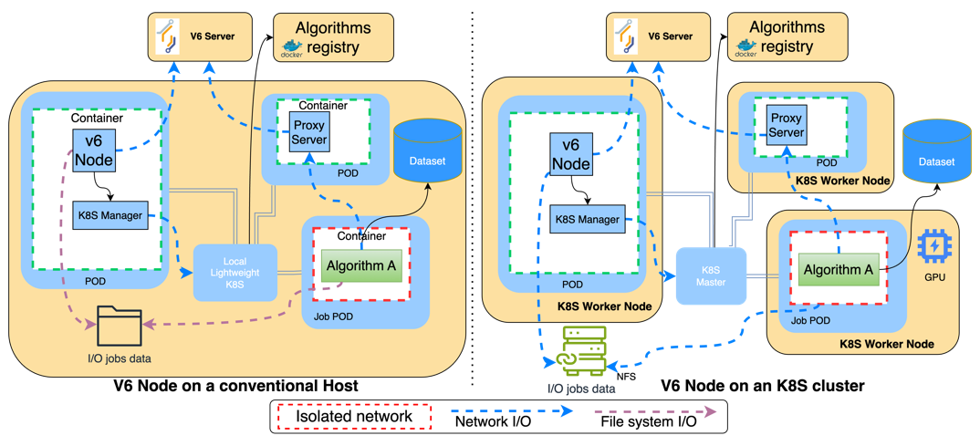

Feature: Kubernetes-compliant v6-node PoC / MVP.
Current
(single-node cluster)
WIP
Drop-in replacement of regular v6 node.
  Based on V6 core libraries + DockerManager refactored as ContainerManager (K8S API).
Already tested for simple federate analysis scenarios:
  Collaborations with regular nodes.
Contributors: Héctor Cadavid, Cunliang Geng (NLeSC)
Estimate: Q2-2025.
https://github.com/vantage6/v6-on-kubernetes-PoC

Slide 19
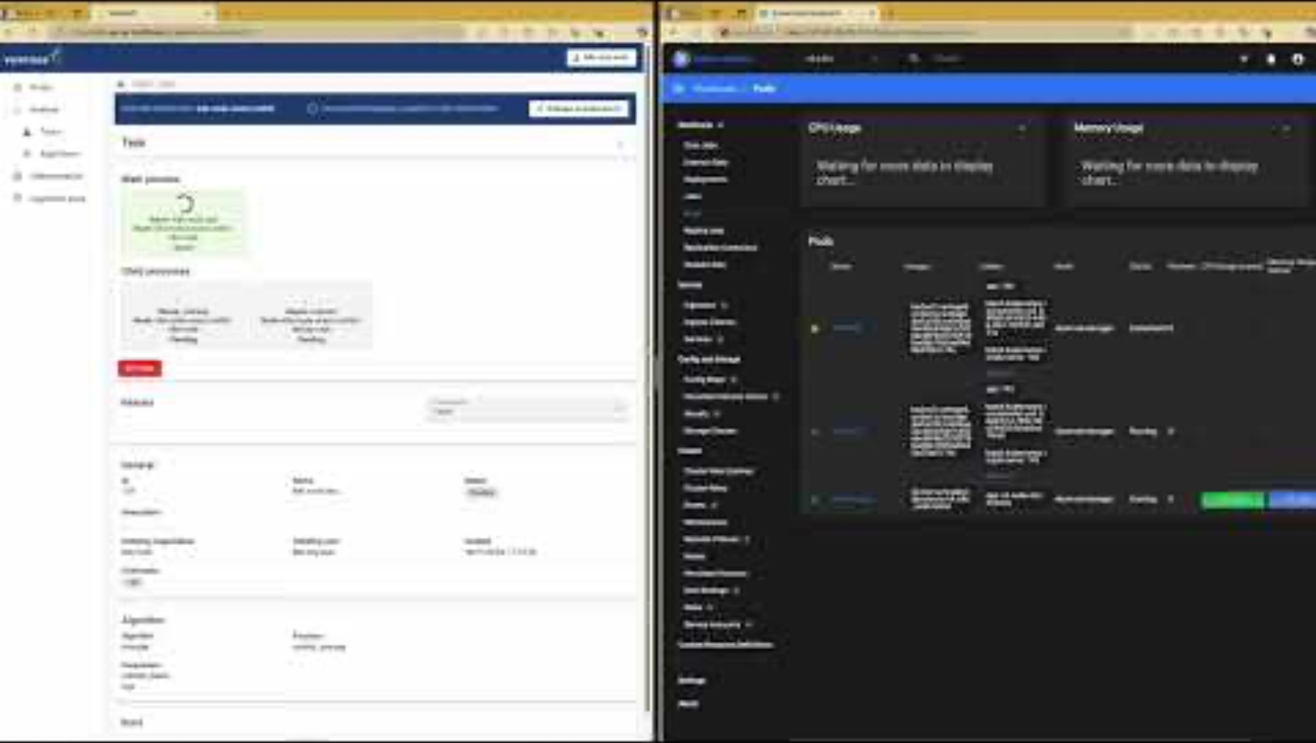

Slide 20
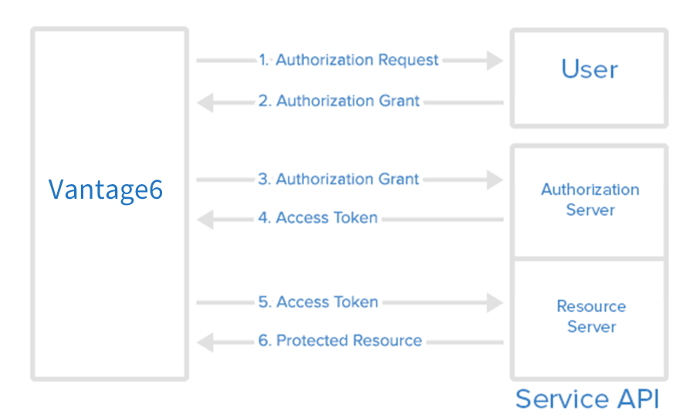


Feature: External authentication
Currently the users access though vantage6 credentials (username and password), but we want to allow them to use external identity providers such as Microsoft, Google, GitHub, etc. to authenticate.
Contributors: Walter Baccinelli, Djura Smits (eScience Center), Bart van Beusekom (IKNL)
Estimate: Q1 2025
[Feature Request] Login using external identity provider #917 · vantage6/vantage6 (github.com)
Notes:
Dit is een voorbeeld

Slide 21

Version 5
We are planning to release a new major version with sessions, Kubernetes, and external authentication as major features.
Estimate: Q1-Q2 2025
What’s next after Cotopaxi?

Slide 22
Algorithm development

Slide 23
Generalized linear modeling
We have an old implementation of GLM in R suitable for vantage6 v2, which will be ported to Python for vantage6 v4.
IKNL/v6-euracan-algorithms: Vantage6 algorithms for the EURACAN project (github.com)

Slide 24
Proposed features

Slide 25
Miscellaneous

Slide 26



Miscellaneous
Questions
Finding common interests by sharing what you are working on
Feedback
Finding common interests by sharing what you are working on
Ideas
Finding common interests by sharing what you are working on

