Slide 1

Community meeting
19th of September 2024
This meeting will
be recorded

Slide 2
The community
Infrastructure Developers
Committers & contributors
Algorithm Developers
Creating federated analysis algorithms
Users
Use vantage6 for privacy preserving analysis

Slide 3


Aim
Collaboration opportunities
Finding common interests by sharing what you are working on
Share what you are working on, Pitch a feature, … (Suggestions?)
Align development efforts
Avoid doing things twice
Bug reports
Please submit these in our issue tracker:
https://github.com/vantage6/vantage6/issues

Slide 4
Agenda
11:00 Short introduction
11:05 Announcements and upcoming events
11:10 Recently released
11:20 Infrastructure development
11:35 Algorithm development
11:45 Proposed features
11:55 Miscellaneous
New!

Slide 5
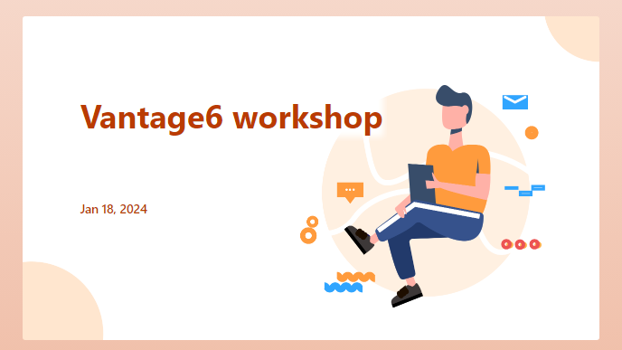


Announcements and upcoming events
Vantage6 workshop
Taking place on: 16-17 October 2024
Organized by eScience Center and IKNL.
Fully booked!
Vantage6 community sprints
We started having 4-week community sprints with eScience Centre, MDW, and IKNL colleagues since June 2024.
The goal of these sprints is to improve the coordination of development efforts between institutes.
Sprints are open to all developers of vantage6!

Slide 6
Recently released
4.5.0-4.7.0 (9 releases)

Slide 7
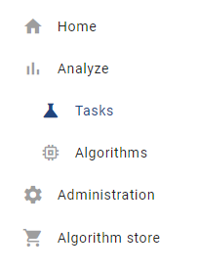
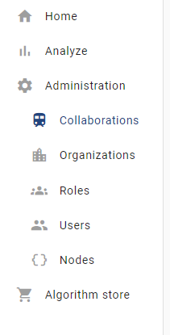
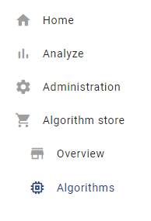

Change: restructuring menus in the UI
While adding new functionality to the UI, the existing menu structure was insufficient. We redesigned it such that it is more easily extensible.
Contributors: Bart van Beusekom, Frank Martin (IKNL)
Estimate: Q2 2024

Slide 8
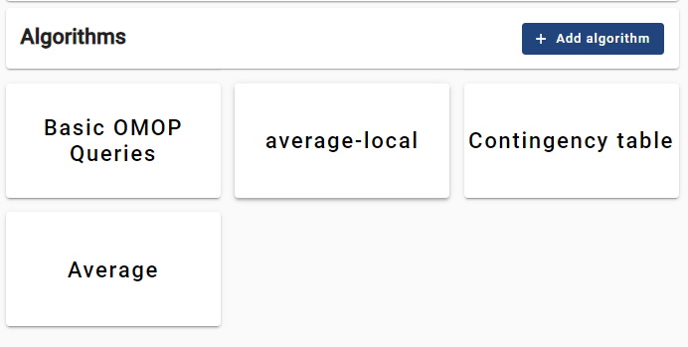
Feature: visualizing algorithms in the UI
The algorithms in the algorithm store are currently visible in a limited way in the UI: only the algorithm names are available from a dropdown when you start a task.
The purpose here is to properly visualize algorithms in the UI and to make it easier to change the algorithms that are currently in the store.
In the future, more metadata on the algorithms should be included in the store, which will also be visualized.
Contributors: Bart van Beusekom (IKNL)
[Feature Request] CRUD for algorithms in the UI

Slide 9
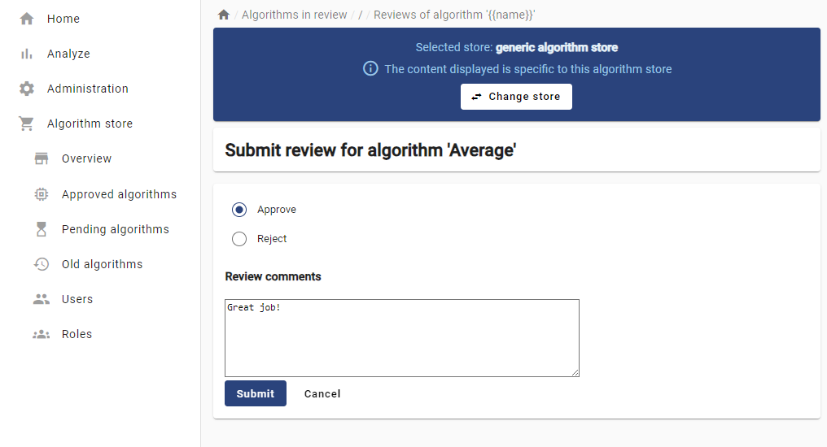

Feature: Algorithm Store review process
The current algorithm store is filled via a one-step process: an authorized developer can put the algorithms directly in the store.
From v4.6, there will be reviewers and store owners. Store owners assign a new algorithm to be reviewed. Only when this is complete, will the algorithms be available to users to be run.
Contributors: Bart van Beusekom, Frank Martin (IKNL); Djura Smits, Walter Baccinelli (eScience Centre)
Estimate: Q3 2024
[Feature Request] Endpoint /review for algorithm store

Slide 10
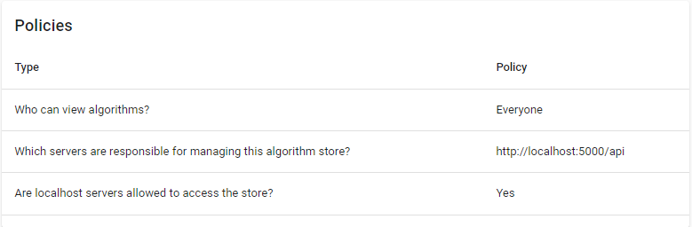
Feature: Algorithm store policies
Algorithm store management requires owners to set policies. For instance, algorithm store owners want to decide if the algorithms in their store are accessible to anyone or to a selected set of vantage6 servers. Also, there are development policies for turning off the algorithm review process.
The policy system can easily be extended with more policies.
Contributors: Bart van Beusekom, Frank Martin (IKNL); Walter Baccinelli (eScience center)
Estimate: Q3 2024
[Feature Request] Settings management for algorithm store

Slide 11

Feature: Allow algorithms by algorithm store
An important security policy in vantage6 is defining which algorithms are allowed on your node. To do this, you can define a list of algorithms or regular expressions.
Since v4.6, you are also able to trust algorithms from certain algorithm stores. This can reduce the administrative burden on node admins if a project has frequent algorithm updates. The stores also include the hashes of the algorithms
Contributors: Bart van Beusekom, Frank Martin (IKNL); Luis Sanchez (MDW); Walter Baccinelli (eScience Centre);
Estimate: Q3 2024
policies:
allowed_algorithm_stores:
- https://store.cotopaxi.vantage6.ai
- https://my_own_store.org
[Feature Request] Option for node administrator to alllow all algorithms from certain store

Slide 12
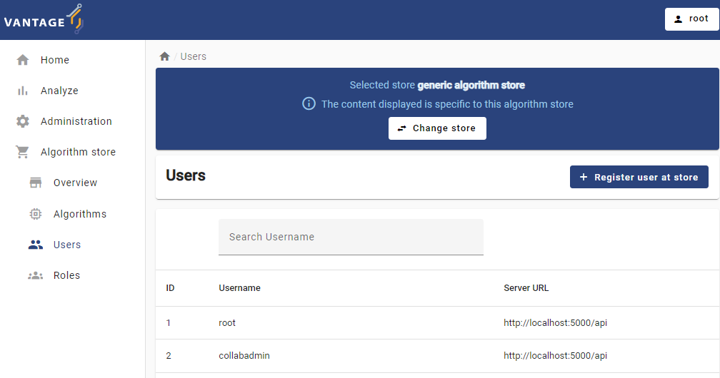
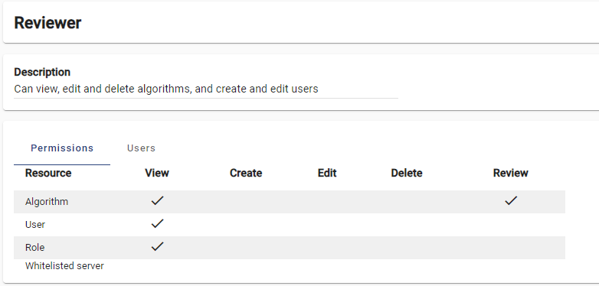
Feature: Algorithm Store admin in UI
Users and permissions in algorithm stores can now also be managed via the UI.
Contributors: Bart van Beusekom (IKNL);
Estimate: Q3 2024
[Feature Request] Manage permissions for algorithm store in UI

Slide 13
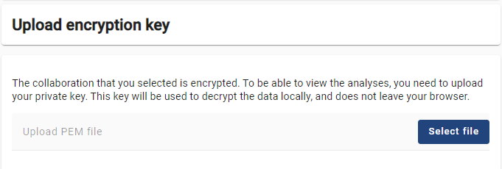
Feature: handling encrypted tasks in the UI
End-to-end encryption in vantage6 is used in encrypted collaborations to encrypt the input and the results of a task. This ensures that task results can only be read with access to the private key.
The UI does not support reading encryption yet – plan is that it will.
Contributors: Bart van Beusekom (IKNL)
Estimate: Q2 2024
[Feature Request] Support encryption in UI

Slide 14
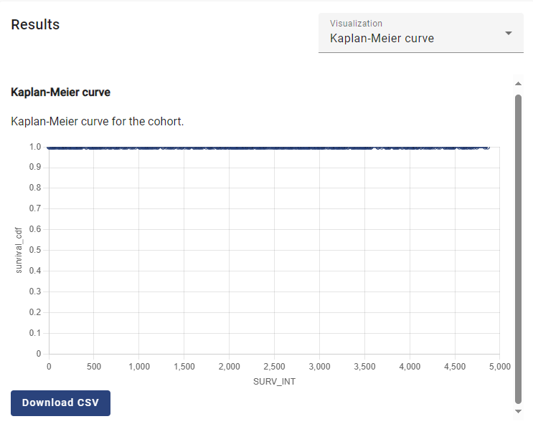
Feature: Line charts in the UI
When you put your algorithm in the algorithm store, you can choose to visualize it with a line. Upon completing a task with that algorithm, the UI will show that line.
Contributors: Bart van Beusekom (IKNL);
Estimate: Q3 2024
We can’t show real results, but the good thing in this curve is that everyone survives
[Feature Request] Add option to visualize line charts

Slide 15


Feature: Compatibility with eduvpn v3
N2n communication feature worked with eduVPN v2, but eduVPN v2 is not compatible with newer linux distros.
We adapted vantage6 to be compatible with eduvpn v3
Unfortunately we had to drop compatibility with eduvpn v2! Let us know if this is a problem!
Contributors: Djura Smits, eScience Center
Estimate: Done
https://github.com/vantage6/vantage6/issues/1180

Slide 16
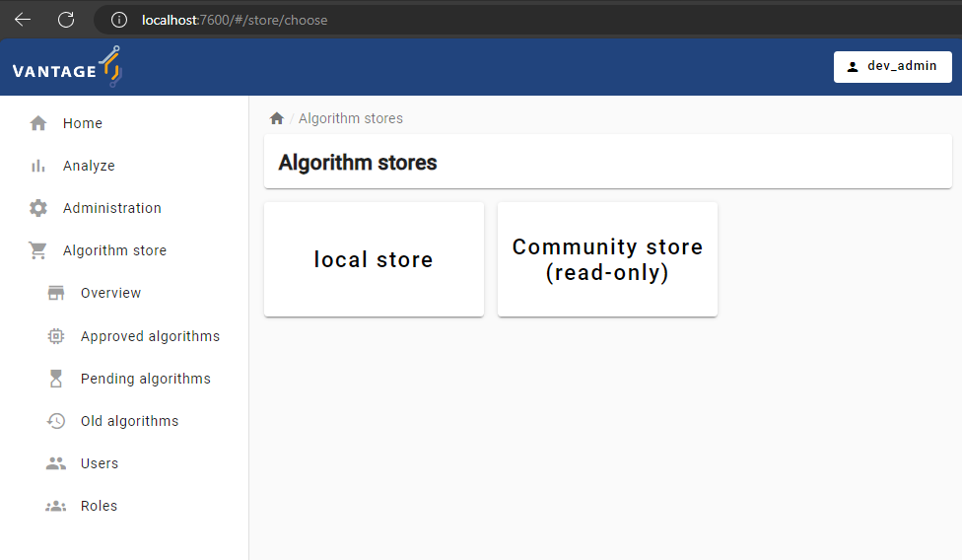
Feature: extend and improve ‘v6 dev’ networks
Via `v6 dev start-demo-network` you can easily start a server and a few nodes in a test network. Since v4.7, a UI and an algorithm store are also added to this test suite.
Also, the test data included on these networks has been improved, so that you can run more interesting algorithms on the test network.
Contributors: Bart van Beusekom (IKNL);
[Feature Request] Add algorithm store and UI to v6 dev network
[Feature Request] Improve data in v6 dev network

Slide 17


Feature: Delete organizations
It was not possible to delete organizations in vantage6 – this should not be a common action so we never implemented it. Now we did.
Contributors: Bart van Beusekom (IKNL);
[Feature Request] Delete organizations from server

Slide 18
Other changes
28
bugfixes
24
changes
22
features
1
security
patch
For full log of changes, see https://docs.vantage6.ai/en/main/release_notes.html
Notes:
Dit is een voorbeeld

Slide 19
Infrastructure development
Upcoming features and changes

Slide 20
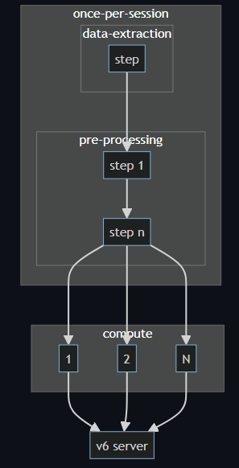
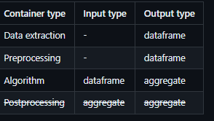
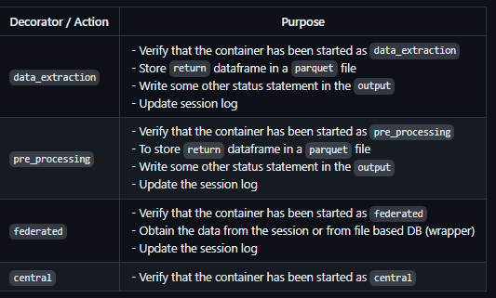
Feature: Algorithm container chaining
Split responsibilities of the algorithm containers:
Data extraction
Preprocessing
Algorithm (federated / central)
It has the following advantages:
The different components can be used modular.
The UI/UX task flow more consistent for different data source types.
Reuse the data-extraction / pre-processing step for multiple analysis making it quicker and less error prone
Contributors: Frank Martin (IKNL), Bart van Beusekom (IKNL), …
Estimate: Q4 2024 - Q1 2025
[Feature Request] Chaining of algorithm containers · Issue #943 · vantage6/vantage6 · GitHub

Slide 21
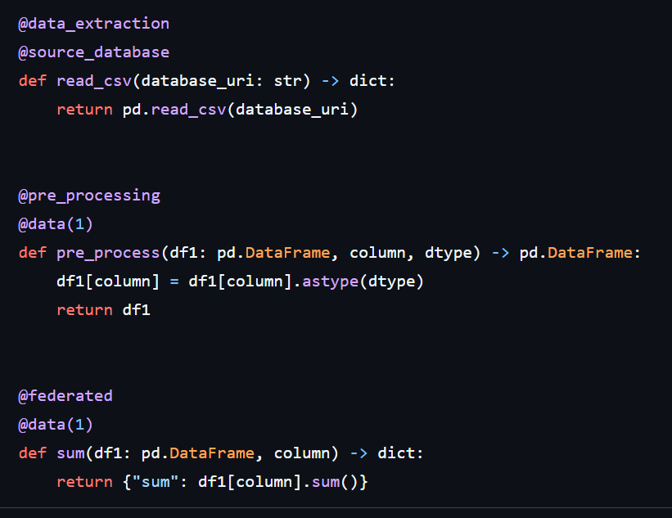
Feature: Algorithm container chaining
Different actions can still be stored in a single file and in a single image.
Migrating old algorithms should be a matter of splitting bigger functions into smaller ones.

Slide 22
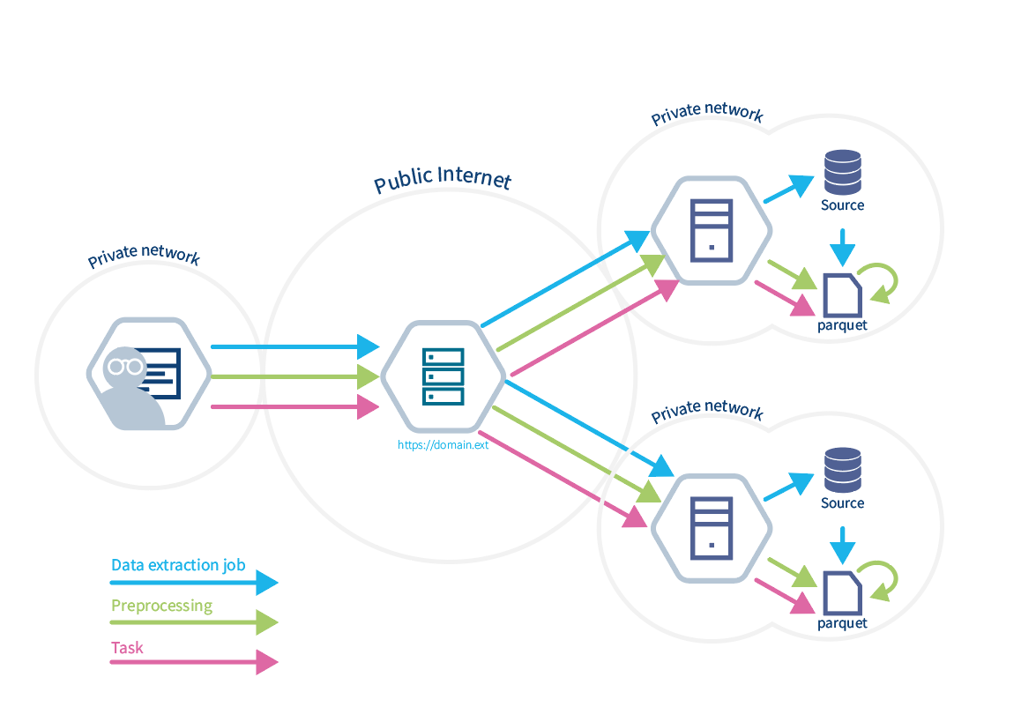
Feature: Algorithm container chaining
Three different requests (researchers can just use one if someone else prepared the dataset).
You can run many tasks on the session data frame
There is a locking mechanism that prevents you from updating data frames that are currently in use by computations
You can add preprocessing steps at a later stage
Use has instant access to column names and types after session initialization

Slide 23
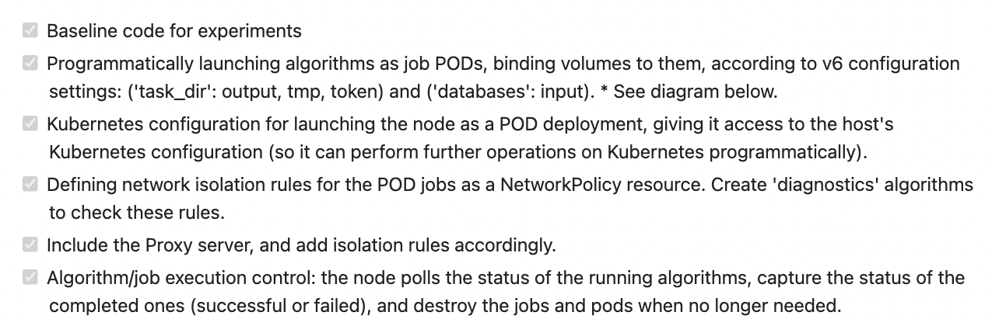
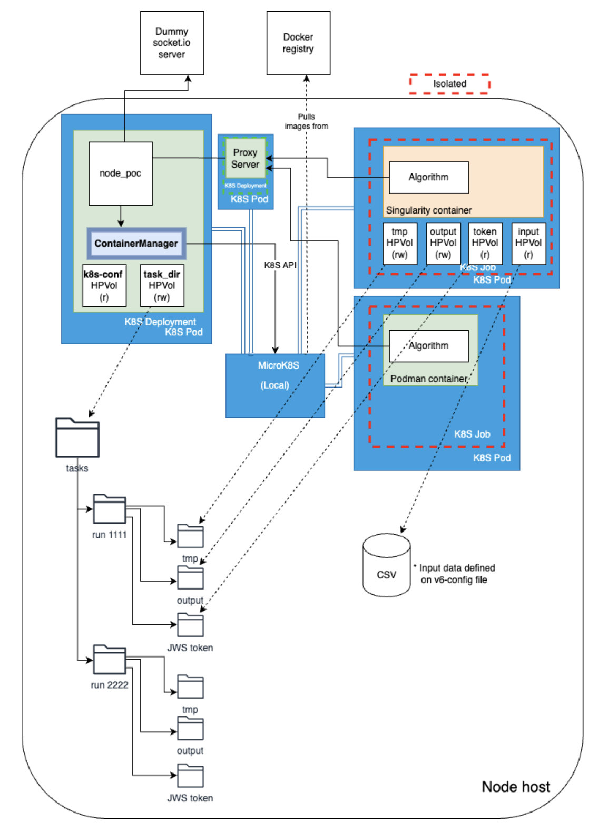
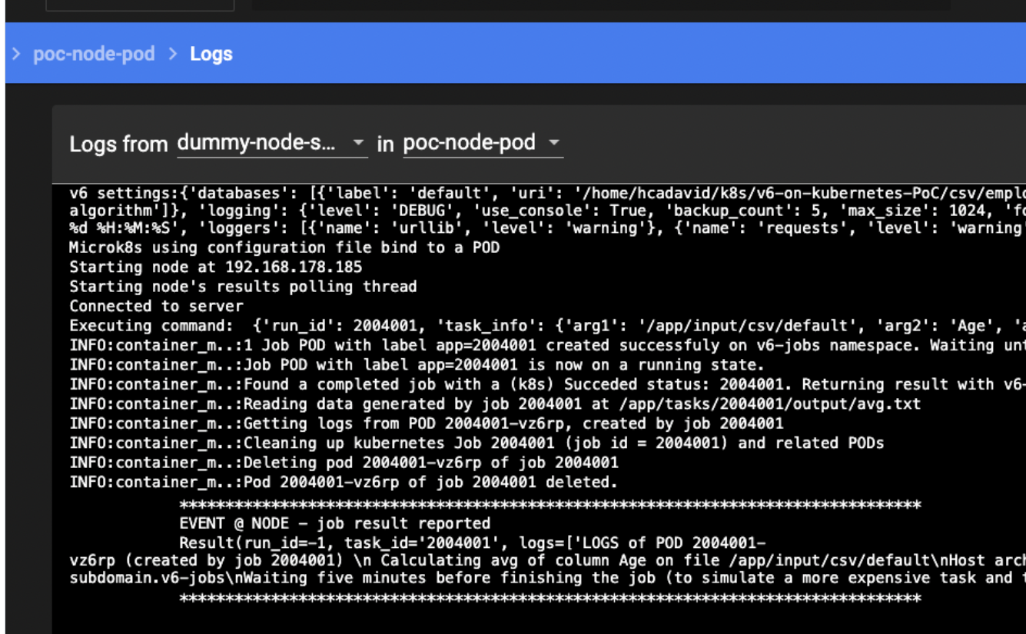

V6 + Kubernetes PoC
healthcare
vantage6
https://github.com/bdh-generalization/v6-on-kubernetes-PoC

Slide 24
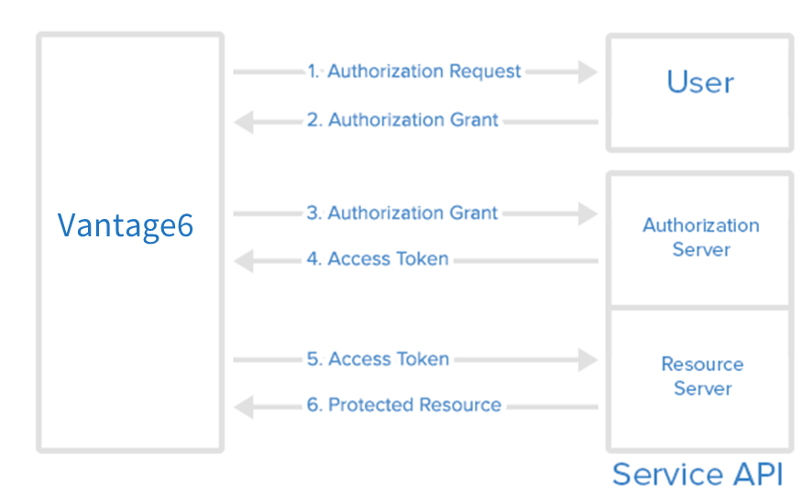
Feature: External authentication
Currently the users access though vantage6 credentials (username and password), but we want to allow them to use external identity providers such as Microsoft, Google, GitHub, etc. to authenticate.
Contributors: Walter Baccinelli, Djura Smits (eScience Center), Bart van Beusekom (IKNL)
Estimate: Q1 2025
[Feature Request] Login using external identity provider #917 · vantage6/vantage6 (github.com)
Notes:
Dit is een voorbeeld

Slide 25

Version 5
We are planning to release a new major version with sessions, Kubernetes, and external authentication as major features.
Estimate: Q1-Q2 2025
What’s next after Cotopaxi?

Slide 26
Algorithm development

Slide 27

Euracan Algorithms: porting to v4
Algorithm suite for the Euracan (European cancer registry) project is at version v2.3.4 and will be ported to version 4.
Ported to v4:
Cross tabulation
  With Chi-squared test
Kaplan-Meier (Adapted from Maastro/MDW version, thank you!)
Summary
TODO:
CoxPH (+assumption test)
Log Rank Test
GLM
IKNL/v6-euracan-algorithms: Vantage6 algorithms for the EURACAN project (github.com)

Slide 28
Proposed features

Slide 29
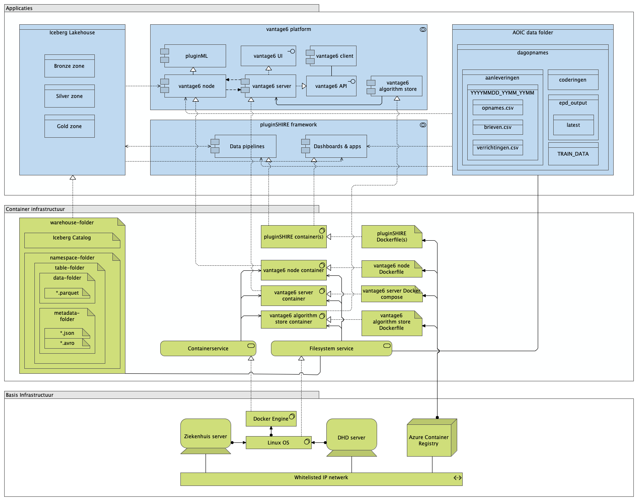


Feature: Operational hardening for multi-collaboration infrastructure
We use vantage6 as the foundational infrastructure for https://plugin.healthcare, which needs to support multiple collaborations on the same physical node.
Contributors: Daniel Kapitan (DHD)
https://github.com/vantage6/vantage6/issues/1458

Slide 30
Miscellaneous

Slide 31



Miscellaneous
Questions
Finding common interests by sharing what you are working on
Feedback
Finding common interests by sharing what you are working on
Ideas
Finding common interests by sharing what you are working on

