Slide 1

Community meeting
16th of May 2024
This meeting will
be recorded

Slide 2
The community
Infrastructure Developers
Committers & contributors
Algorithm Developers
Creating federated analysis algorithms
Users
Use vantage6 for privacy preserving analysis

Slide 3


Aim
Collaboration opportunities
Finding common interests by sharing what you are working on
Share what you are working on, Pitch a feature, … (Suggestions?)
Align development efforts
Avoid doing things twice
Bug reports
Please submit these in our issue tracker:
https://github.com/vantage6/vantage6/issues

Slide 4
Agenda
11:00 Short introduction
11:05 Announcements and upcoming events
11:10 Recently released
11:25 Infrastructure development
11:40 Algorithm development
11:55 Miscellaneous

Slide 5
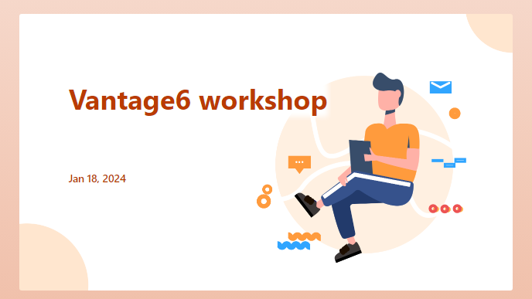


Announcements and upcoming events
Vantage6 workshop
Save the date: 16-17 October 2024
Organized by eScience Center and IKNL.
Spread the word!
Vantage6 community sprints
Starting in June, we will start having 4-week community sprints with eScience Centre, MDW, and IKNL colleagues.
The goal of these sprints is to improve the coordination of development efforts between institutes.
Sprints are open to all developers of vantage6!

Slide 6
Recently released
4.3.3-4.4.1 (4 releases)

Slide 7
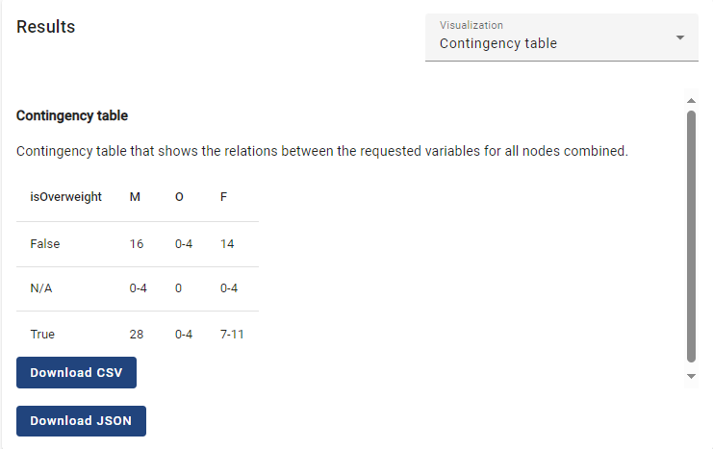

Visualizing algorithm results
Tabular results of algorithms are now shown in the UI. To achieve this, the algorithm must be registered with a table visualization in the algorithm store.
The visualization system is set up such that new types of visualizations can be added easily.
Contributors: Bart van Beusekom, Frank Martin (IKNL);
[Feature Request] Algorithm visualization

Slide 8
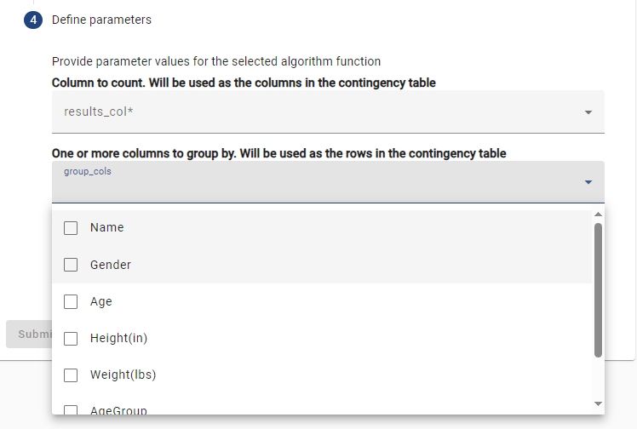
Support for more argument types in the UI
We added a series of error classes to use in algorithms. By using these, algorithm developers can provide more accurate errors to the users.
It is our intention to further extend this functionality in the future so that when these specific errors are raised, the UI will clearly show the type of the error.
Contributors: Bart van Beusekom, Frank Martin (IKNL);
[Feature Request] Support argument list types

Slide 9
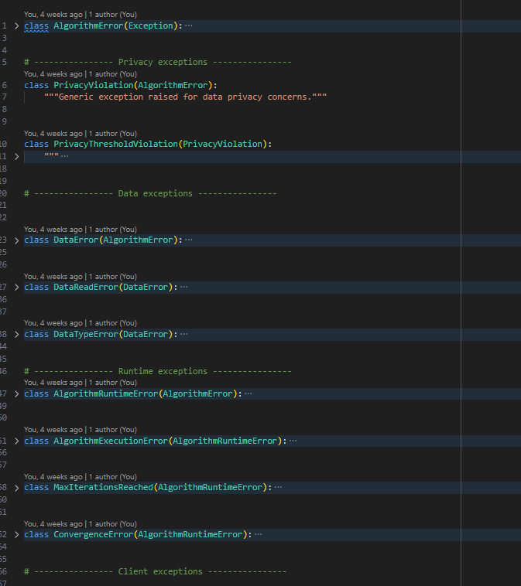
Added vantage6 algorithm error classes
When running an algorithm in the UI, the researcher has to provide values for the arguments that the algorithm function requires. In v4.4, we added the option to use:
List of columns
List of strings/ints/floats
Booleans
We believe that now all required column types are supported.
Contributors: Bart van Beusekom, Frank Martin (IKNL);
[Feature Request] Create custom exception classes for algorithms

Slide 10
Other changes
12
bugfixes
7
changes
8
features
2
security
patches
For full log of changes, see https://docs.vantage6.ai/en/main/release_notes.html
Notes:
Dit is een voorbeeld

Slide 11
Infrastructure development
Upcoming features and changes

Slide 12
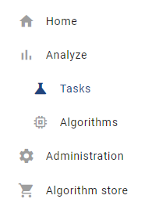
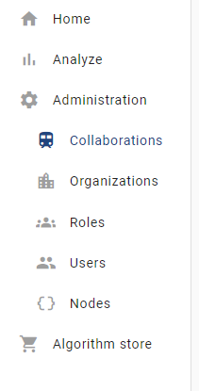
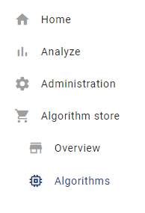
Change: restructuring menus in the UI
While adding new functionality to the UI, the existing menu structure was insufficient. We redesigned it such that it is more easily extensible.
Contributors: Bart van Beusekom, Frank Martin (IKNL)
Estimate: Q2 2024

Slide 13
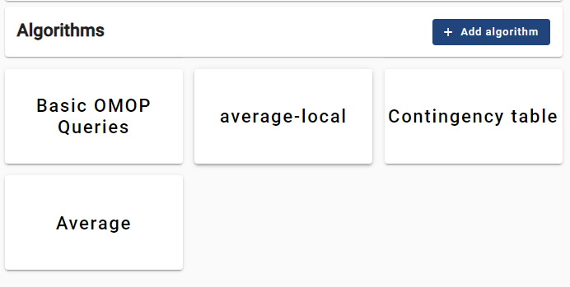
Feature: visualizing algorithms in the UI
The algorithms in the algorithm store are currently visible in a limited way in the UI: only the algorithm names are available from a dropdown when you start a task.
The purpose here is to properly visualize algorithms in the UI and to make it easier to change the algorithms that are currently in the store.
In the future, more metadata on the algorithms should be included in the store, which will also be visualized.
Contributors: Bart van Beusekom (IKNL)
Estimate: Q2 2024
[Feature Request] CRUD for algorithms in the UI

Slide 14
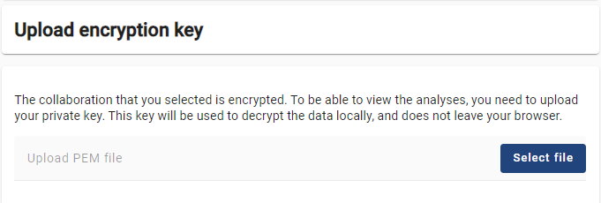
Feature: handling encrypted tasks in the UI
End-to-end encryption in vantage6 is used in encrypted collaborations to encrypt the input and the results of a task. This ensures that task results can only be read with access to the private key.
The UI does not support reading encryption yet – plan is that it will.
Contributors: Bart van Beusekom (IKNL)
Estimate: Q2 2024
[Feature Request] Support encryption in UI

Slide 15






Feature: Algorithm Store review process
The current algorithm store is filled via a one-step process: an authorized developer can put the algorithms directly in the store.
Plan is to have new roles: reviewers and store owners. Store owners assign a new algorithm to be reviewed. Only when this is complete, will the algorithms be available to users to be run.
Contributors: Bart van Beusekom, Frank Martin (IKNL); Djura Smits, Walter Baccinelli (eScience Centre)
Estimate: Q2-3 2024
[Feature Request] Algorithm store

Slide 16

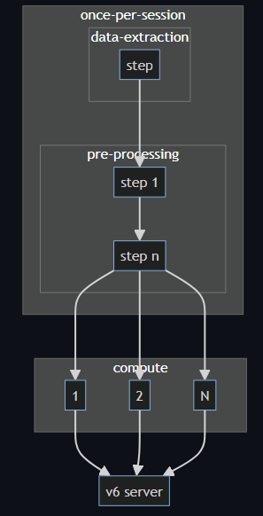
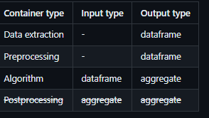
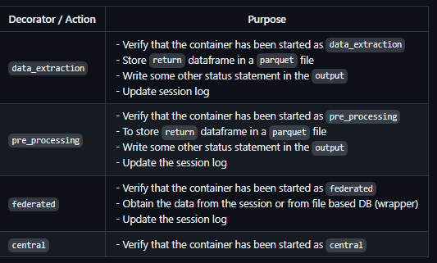
Feature: Algorithm container chaining
Split responsibilities of the algorithm containers:
Data extraction
Preprocessing
Algorithm (federated / central)
It has the following advantages:
The different components can be used modular.
The UI/UX task flow more consistent for different data source types.
Reuse the data-extraction / pre-processing step for multiple analysis making it quicker and less error prone
Contributors: Frank Martin (IKNL), Bart van Beusekom (IKNL), …
Estimate: Q3 2024
[Feature Request] Chaining of algorithm containers · Issue #943 · vantage6/vantage6 · GitHub

Slide 17
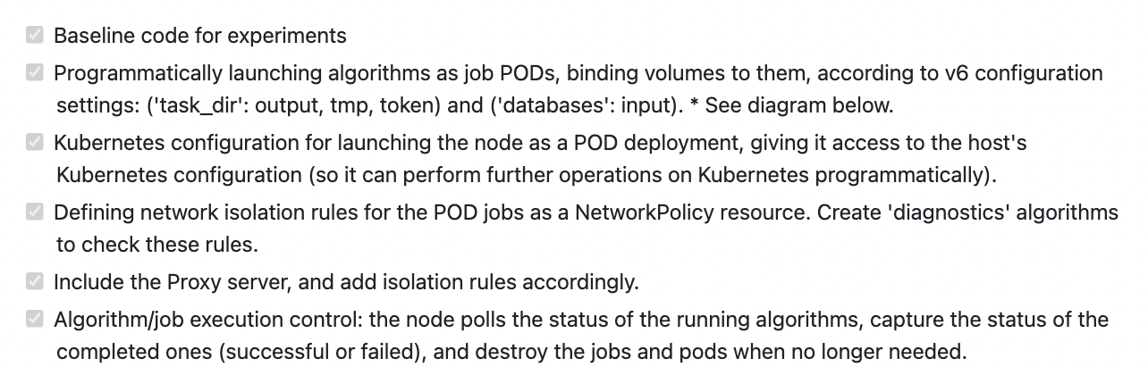
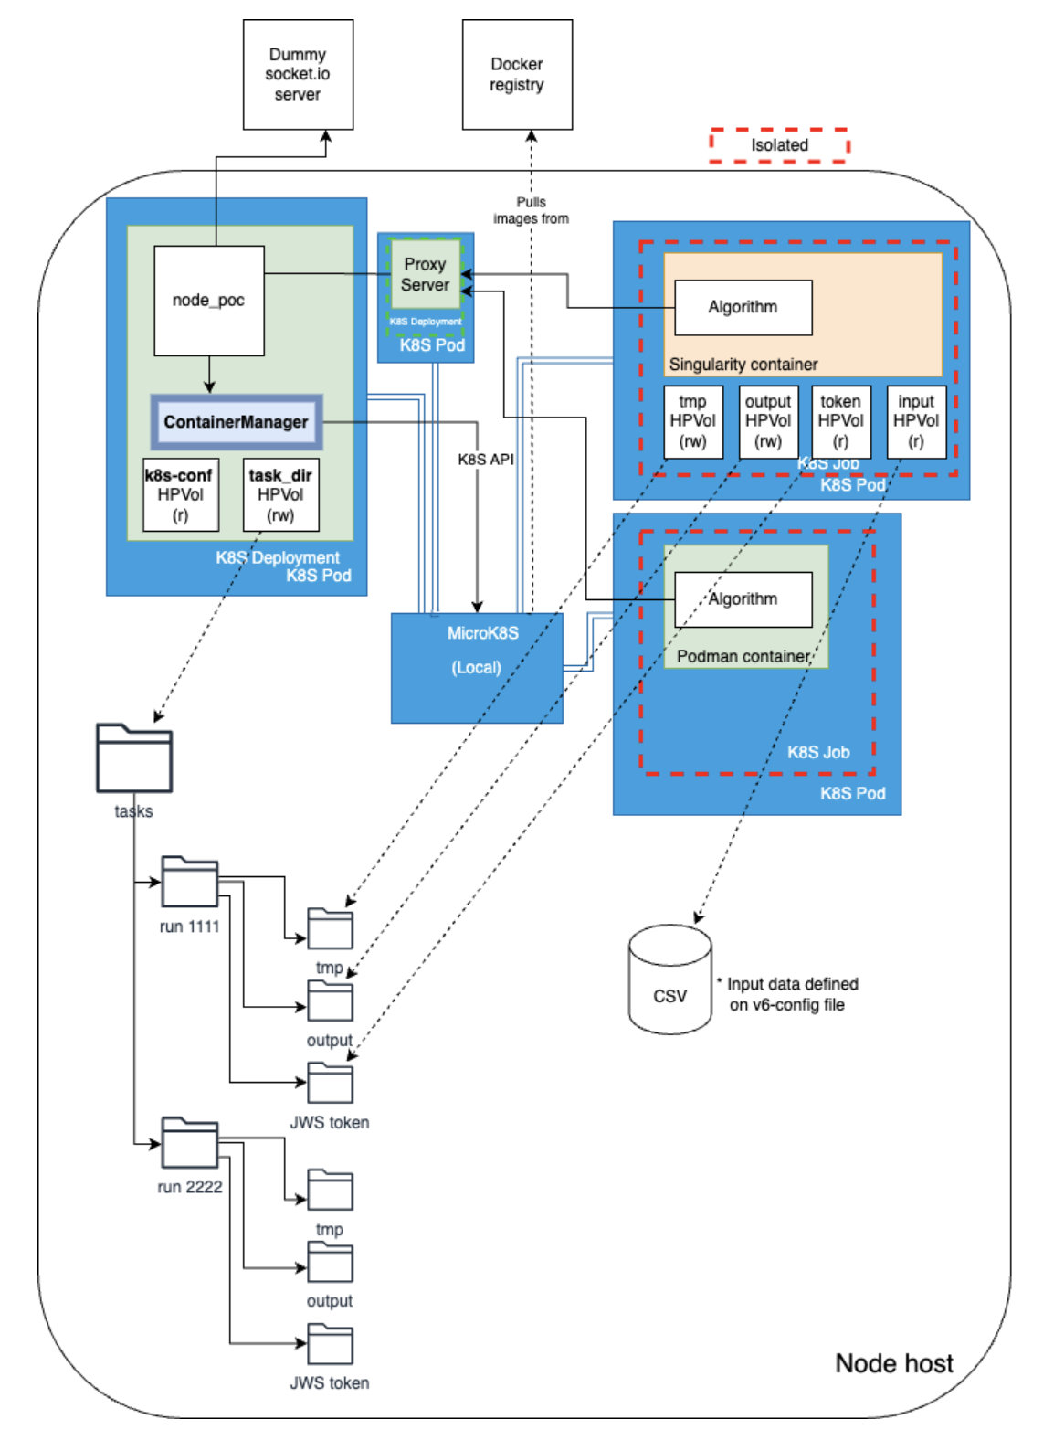
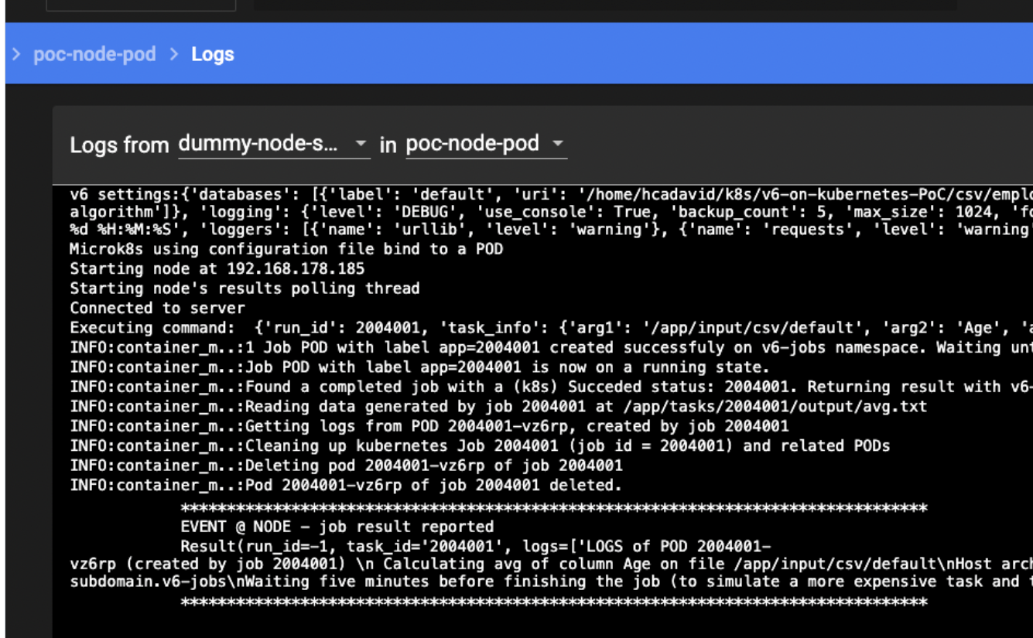

V6 + Kubernetes PoC
healthcare
vantage6
https://github.com/bdh-generalization/v6-on-kubernetes-PoC

Slide 18
Algorithm development

Slide 19

Euracan Algorithms: porting to v4
Algorithm suite for the Euracan (European cancer registry) project is at version v2.3.4 and will be ported to version 4 later this year.
Ported to v4:
Cross tabulation
  With Chi-squared test
TODO:
Summary
CoxPH (+assumption test)
Kaplan-Meier
Log Rank Test
GLM
IKNL/v6-euracan-algorithms: Vantage6 algorithms for the EURACAN project (github.com)

Slide 20
Miscellaneous

Slide 21



Miscellaneous
Questions
Finding common interests by sharing what you are working on
Feedback
Finding common interests by sharing what you are working on
Ideas
Finding common interests by sharing what you are working on

